Slide 1
Vue Mixins

Slide 2
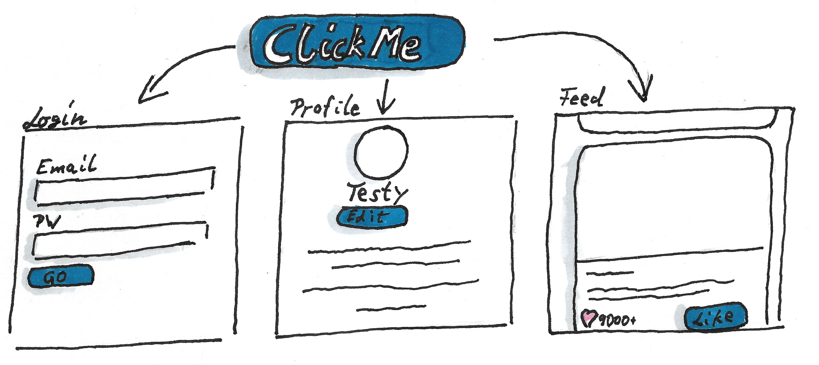
What is the benefit of VueJS?
Reusability
Encapsulation

Slide 3

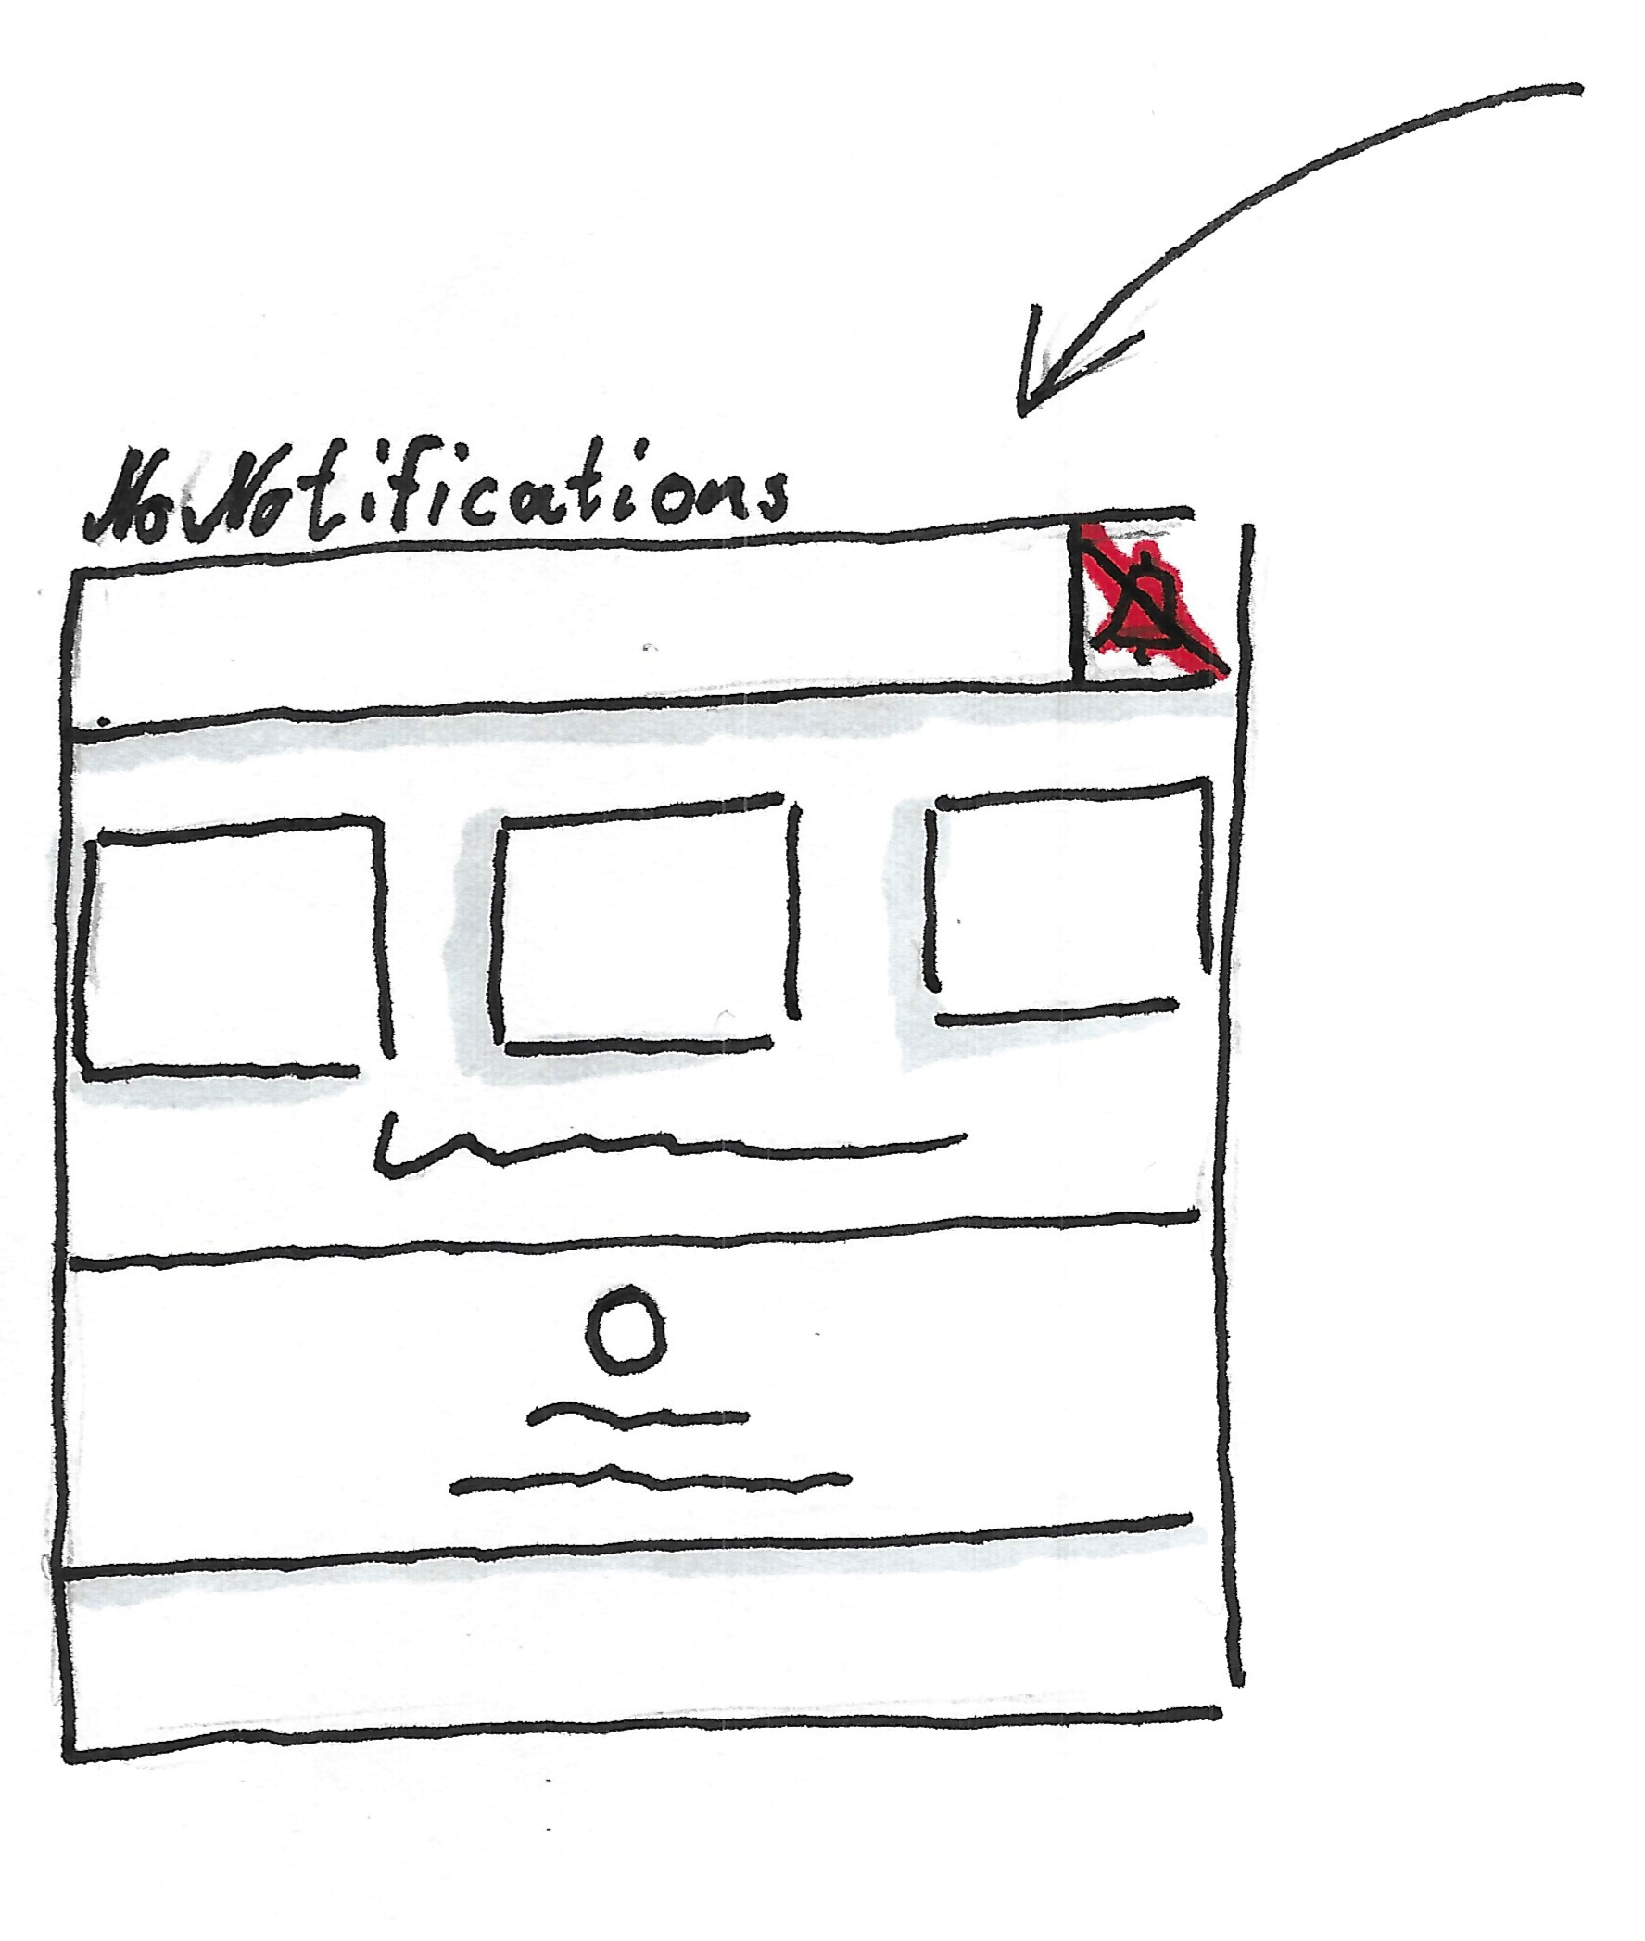

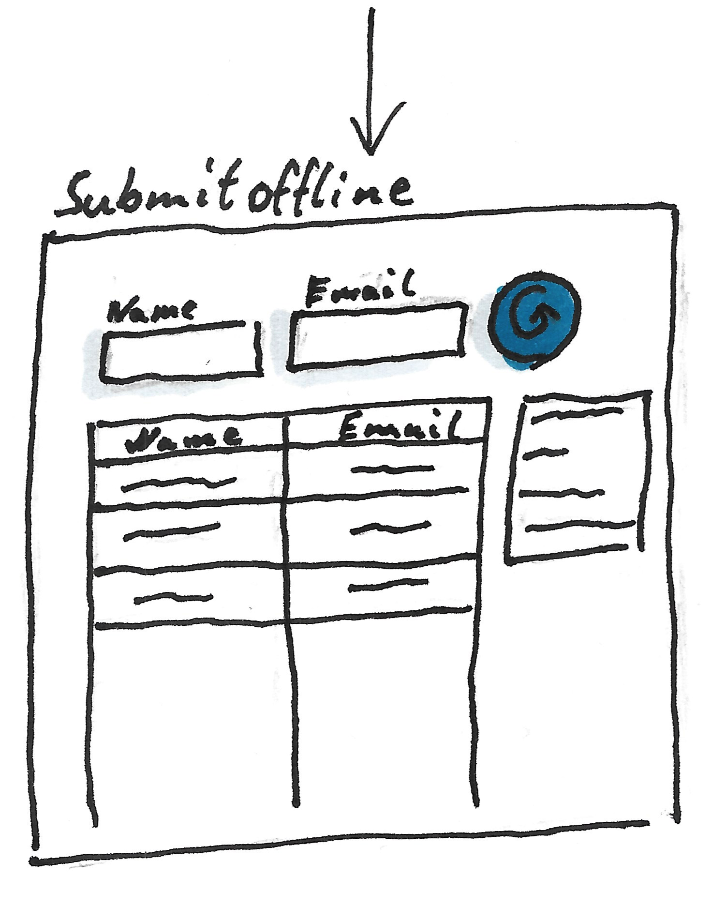
What about functionality?

Slide 4

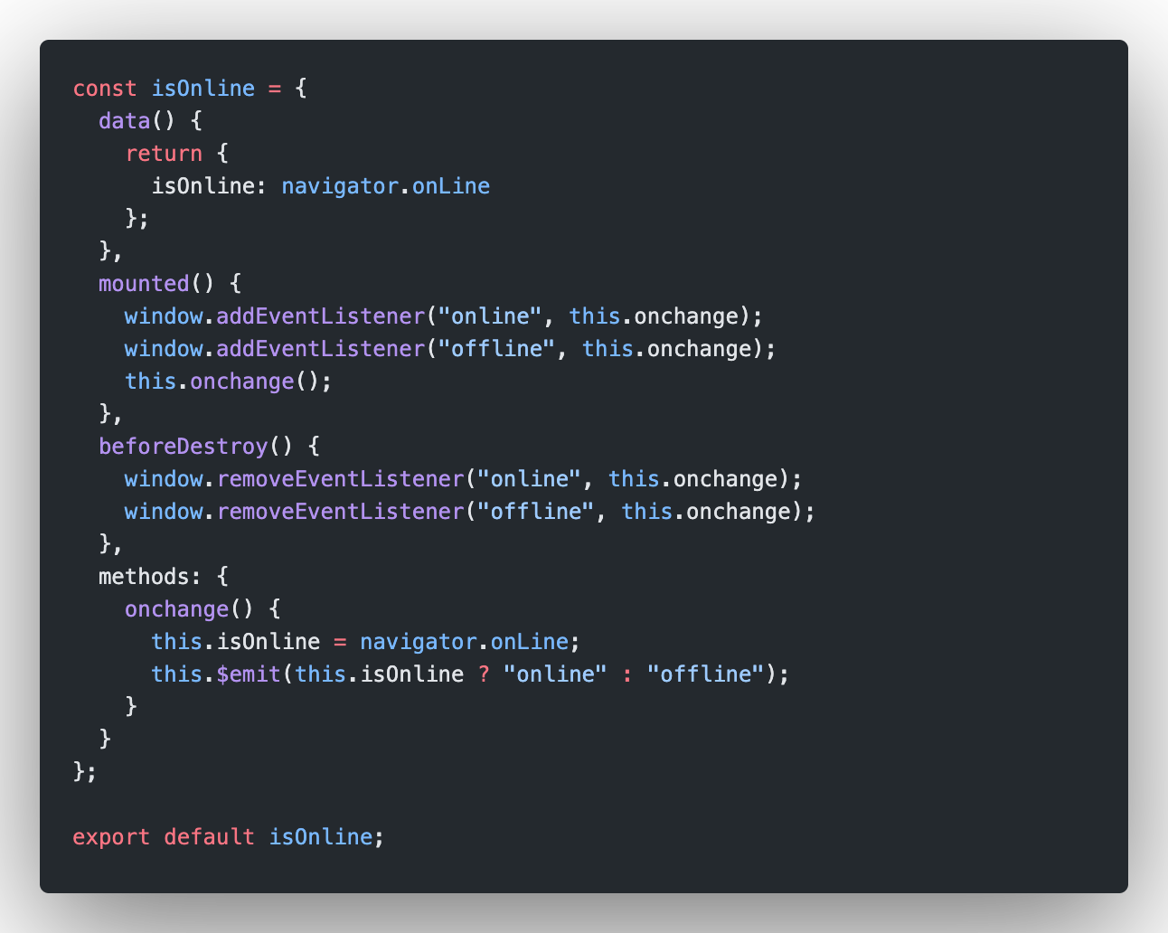



Meet Mixins!

Slide 5
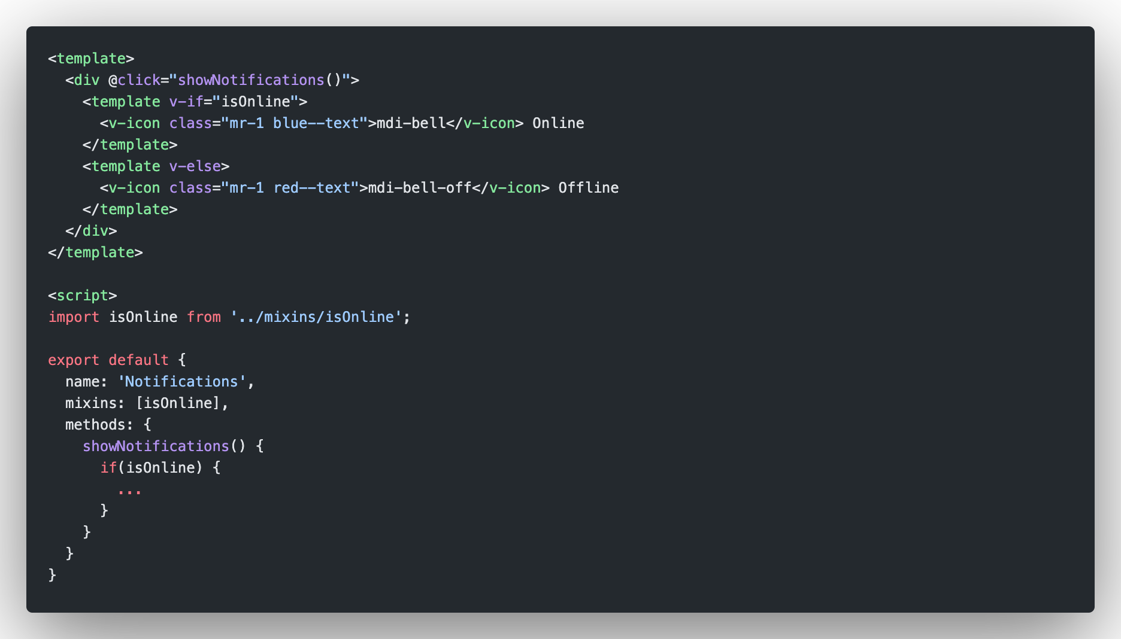
Component import

Slide 6
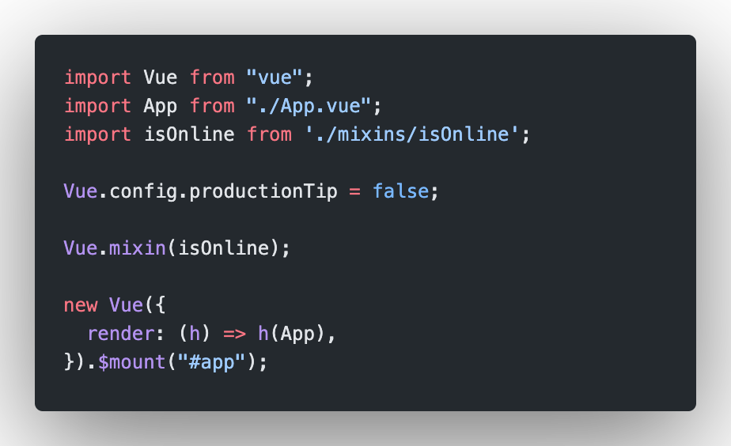
Global import

Slide 7
Demo Time

Slide 8
Where to find more information?
Documentation: https://vuejs.org/v2/guide/mixins.html
Vue Masters: https://www.vuemastery.com/courses/next-level-vue/mixins/
The new kid on the block:
Composition API (Vue 3): https://v3.vuejs.org/guide/composition-api-introduction.html#why-composition-api
Demo Repo: https://github.com/KirioXX/vue-toaster

